Slide 1
Running Code in .NET
Senior Security Consultant - Rapid7

Slide 2
Introduction
Nick Spagnola
Red teamer at Rapid7
Adjunct Professor – University of Cincinnati
Spend a lot of time not on assessments writing payloads / devving red team stuff
Wrote a mythic agent
Primarily using .NET

Slide 3
What is .NET
.NET is an open-source development framework created by Microsoft
The primary ways to interact with .NET are probably Powershell and C#
For the sake of this talk, when referring to .NET assume I am specifically talking about C#.
.NET is built on the Common Language Runtime (CLR)
C# is an interpreted language meaning the code first gets compiled down into an intermediate language (MSIL) by the compiler.
When you execute a .NET assembly, the CLR will compile the intermediate language into machine code via Just-in-Time Compilation (JIT)

Slide 4
What Makes .NET So Fun
.NET is open-source so you can look at all of the source code
.NET assemblies can be decompiled back into their original C# source making it very easy to reverse engineer facets of .NET
.NET contains built-in functionality to load assemblies into current process space
The development time for .NET tooling is very short and simple
C = Boomer, C# = Zoomer

Slide 5
Reflection Library
The main core of what is shared will rely on the reflection library
The essential functionality of the reflection library is that it allows you to access information about .NET assemblies.
Get info about Types in the assembly
Access various fields and attributes in an assembly
Etc
You can also use the reflection library to dynamically create different types, methods, and assemblies
You can also load / execute assemblies in memory.

Slide 6
Loading Via Reflection
Reflection lets you load an assembly in multiple ways
Via path on disc
Via assembly full name (Fully Qualified Assembly Name)
Via byte string
Assembly full name is the name of the executable + additional information like version
ExampleAssembly, Version=0.0.0.0, Culture=neutral, PublicKeyToken=null
Assembly full names are located in the following
Current directory (Derived from ImagePath) - this will be important
Current directory\[Name of Assembly]\[Name of assembly]
So ExampleAssembly will be
[CurrentDir]\ExampleAssembly.dll
[CurrentDir]\ExampleAssembly\ExampleAssembly.dll

Slide 7
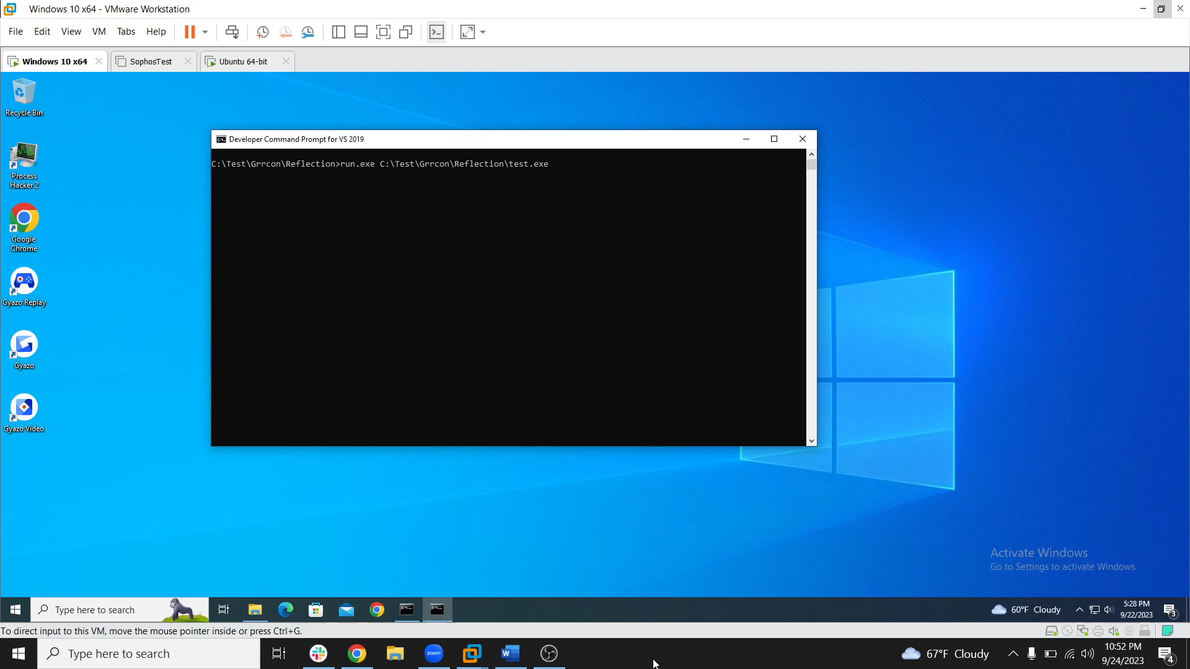
Reflection Example

Slide 8
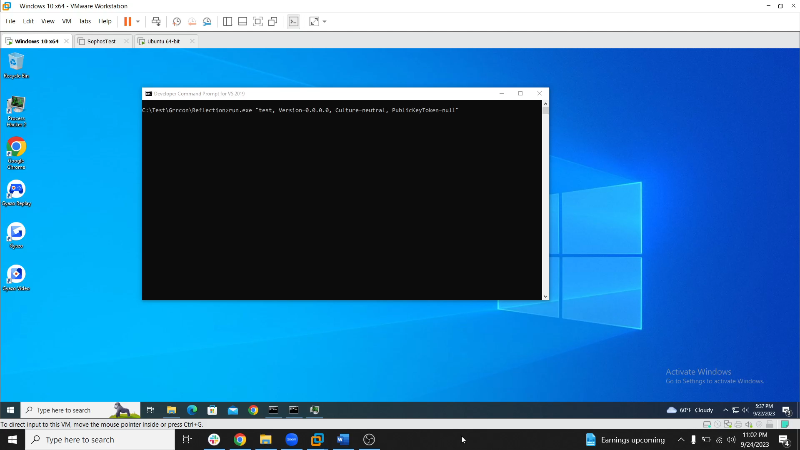
Reflection Via Assembly FullName

Slide 9

Reflection Via Assembly FullName 2

Slide 10
Lolbins Utilizing Reflection
Some Windows lolbins revolve around reflection loading assemblies.
Example:
InstallUtil.exe
InstallUtil.exe will call a method InstallHelper
This method will check if we are attempting to install or uninstall server resources
The method will then load the assembly and execute either the Install or Uninstall method in the loaded assembly
To execute our code we create an assembly that inherits from System.Configuration.Install.Installer and override the method we want to use (usually Uninstall)

Slide 11
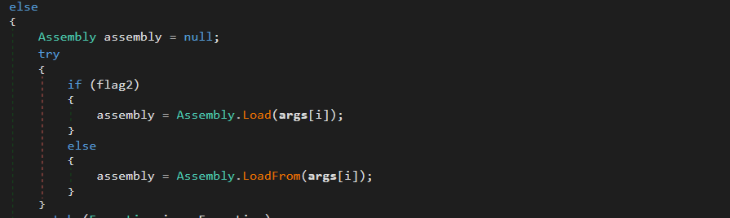
ManagedInstallerClass.InstallHelper Assembly Load

Slide 12
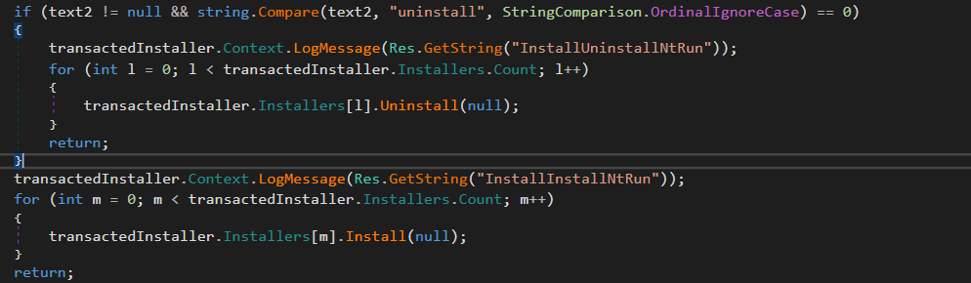
ManagedInstallerClass.InstallHelper Execute

Slide 13

InstallUtil Lolbin

Slide 14
Abusing .NET for DLL Loads
Multiple facets of .NET Framework and .NET Core can be abused for loading malicious DLLs
Defining custom Garbage Collectors
COR Profilers
AppDomain Managers

Slide 15
Garbage Collector
.NET is built on the Common Language Runtime (CLR)
The CLR contains a Garbage Collector that helps manage memory allocations within the program.
When objects are created, the GC allocates memory for that object on the heap
When too much memory is being used, the GC frees up any unused objects so that memory can be allocated to new objects.
.NET allows for you to specify a standalone GC
We can tell the .NET Execution Engine to load the standalone GC via the COMPlus_GCName Environment Variable
The EE will then attempt to call the GC_VersionInfo exported functionEx

Slide 16
Loading the Standalone GC
Thanks to some great work by am0nsec
https://github.com/am0nsec
https://twitter.com/am0nsec?ref_src=twsrc%5Egoogle%7Ctwcamp%5Eserp%7Ctwgr%5Eauthor
Normally Dotnet core searches for the standalone GC in the installation path of Dotnet Core.
However, there is a path traversal vulnerability in the logic to load the GC

Slide 17

Standalone GC Example (PoC from ired.team)

Slide 18
COR Profiler
Originally found on 0xdf blog and hackplayers blog
Profiling defined by Microsoft
A profiler is a tool that monitors the execution of another application. A common language runtime (CLR) profiler is a dynamic link library (DLL) that consists of functions that receive messages from, and send messages to, the CLR by using the profiling API. The profiler DLL is loaded by the CLR at run time.
TLDR it is an unmanaged DLL that we can specify the .NET framework load at run time
In prior to Framework 4, profilers had to be registered but not any longer
To define a profiler set the environment variables
COR_ENABLE_PROFILING=1
COR_PROFILER={any random GUID}
COR_PROFILER_PATH=[path on disc]

Slide 19

Cor Profiler Example

Slide 20
AppDomain Managers
Originally found on Pentest Laboratories (they call out Casey Smith so shout out subtee)
AppDomain managers allow you to effectively turn any .NET assembly on disc into a lolbin.
Even assemblies in the Microsoft.Net folder as a standard user
Two ways to load an AppDomain Manager
Assembly configuration file using the <appdomainManagerAssembly> and <appdomainManagerType> values.
APPDOMAIN_MANAGER_ASSEMBLY and APPDOMAIN_MANAGER_TYPE environment variables.
Both have their benefits

Slide 21
Application Domains Defined
Application Domains provide isolation between applications
C / C++
An application is isolated via processes, each process runs and application and processes isolate applications from each other
C#
Application Domains isolate applications from each other meaning you can have multiple applications running in a single process with multiple application domains
Faults in one application won’t affect the other
One application can be completely unloaded from the process without terminating the entire process.

Slide 22
Creating an AppDomain Manager
An Application Domain Manager handles the creation and management of appdomains
An AppdomainManager is a managed DLL that inherits from the built-in AppDomainManger class
Specify some code to run on startup by overriding the InitializeAppDomain method and including our code to run
Two main ways to load our custom AppDomainManager (AppDomainManager Injection). Casey Smith and GhostLoader PoC was the first project to highlight this iirc
Environment variables
Configuration Files

Slide 23
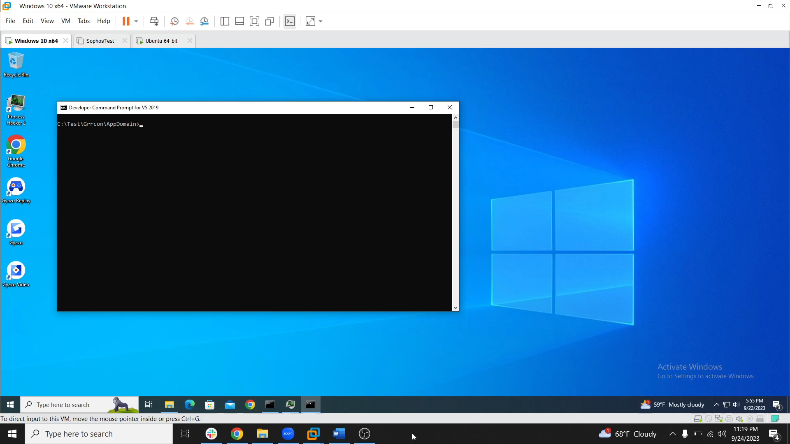
AppDomain Manager Example via Config File

Slide 24
Some Obvious Flaws
AppDomain Manager DLL has to be in the same path as the assembly you plan on loading the DLL into
Requires
An assembly in a user writable spot
To move and assembly from its native location to a user writable spot

Slide 25
Overcoming Flaws
The AppDomain Manager assembly is loaded via assembly full name
As previously discussed, assembly full name will search in
Current directory (Derived from ImagePath)
Current directory\[Name of Assembly]\[Name of assembly]
If we want to load our AppDomain Manager DLL into an assembly located in C:\Windows\System32 all we need to do is place our DLL into a writable folder off of C:\Windows\System32
C:\Windows\System32\Tasks
C:\Windows\System32\fxstmp
First reported by Casey Smith (subtee) I believe

Slide 26
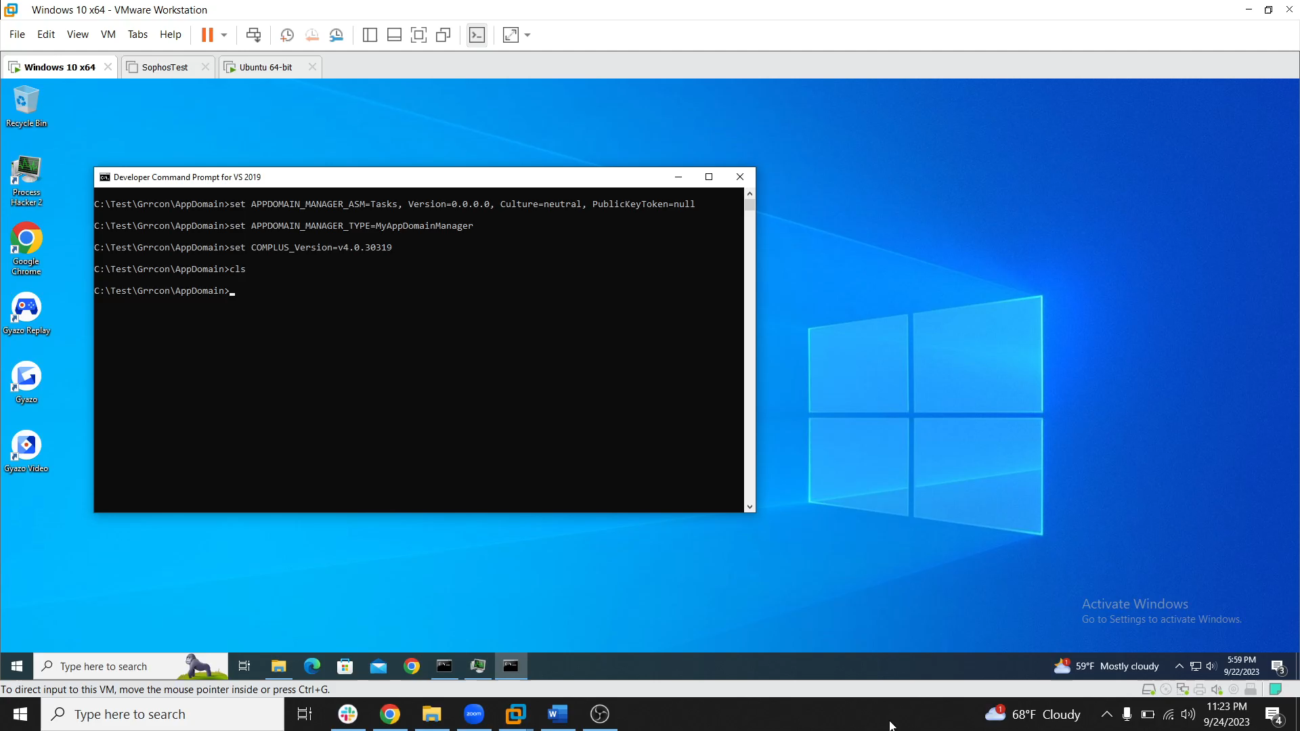
AppDomain Manager Example via Env Variables

Slide 27
Okay But What About Other Assemblies
Because the directory to load the AppDomain Manager is derived from the image path, we can spoof the image path in RTL_USER_PROCESS_PARAMETERS struct to point to a directory we control. This effectively turns ANY .NET assembly on disk into a lolbin.
This will use the RtlCreateProcessParametersEx and RtlCreateUserProcess NTAPI calls to set the RTL_USER_PROCESS_PARAMETERS struct and start the target process
Performing this will allow the targeted assembly to remain and run in its native path while still forcing the assembly to load our DLL
Shout Out
Octoberfest7 – Posted original tweet that kicked this off
Snovvcrash – Posted a spoofing PoC using the above API calls

Slide 28
RTL_USER_PROCESS_PARAMETERS { public ulong MaximumLength; public ulong Length; public ulong Flags; public ulong DebugFlags; public IntPtr ConsoleHandle; public ulong ConsoleFlags; public IntPtr StandardInput; public IntPtr StandardOutput; public IntPtr StandardError; public CURDIR CurrentDirectory; public String DllPath; public String ImagePathName; public String CommandLine; public IntPtr Environment; …………… Snipped }

Slide 29
String WinDir = Environment.GetEnvironmentVariable("windir"); IntPtr uSystemDir = CreateUnicodeStruct(WinDir + "\\System32"); IntPtr uTargetPath = CreateUnicodeStruct("C:\\Test\\Grrcon\\AppDomain\\powershell.exe"); IntPtr uWindowName = CreateUnicodeStruct("Powershell"); IntPtr uCurrentDir = CreateUnicodeStruct("C:\\Windows\\System32\\WindowsPowerShell\\v1.0"); IntPtr desktopInfo = CreateUnicodeStruct(@"WinSta0\Default"); IntPtr uCommandLine = CreateUnicodeStruct("C:\\Windows\\System32\\WindowsPowerShell\\v1.0\\powershell.exe"); IntPtr pProcParams = IntPtr.Zero; UInt32 status = RtlCreateProcessParametersEx(ref pProcParams, uTargetPath, uSystemDir, uCurrentDir, uCommandLine,pointer, uWindowName, IntPtr.Zero, IntPtr.Zero, IntPtr.Zero, 1); ........ SNIPPED ........ IntPtr imagePath = CreateUnicodeStruct("\\??\\C:\\Windows\\System32\\WindowsPowerShell\\v1.0\\powershell.exe"); status = RtlCreateUserProcess(imagePath, 0, pProcParams, IntPtr.Zero, IntPtr.Zero, Process.GetCurrentProcess().Handle,true, IntPtr.Zero, IntPtr.Zero, out procInfo);

Slide 30
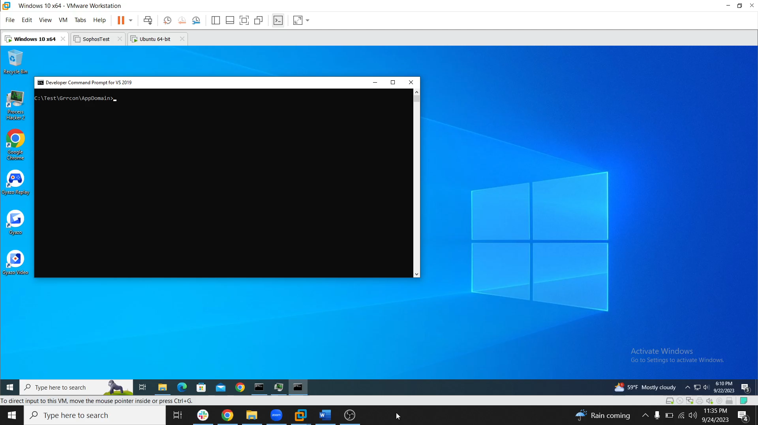
Anywhere Appdomain Manager Example

